Slide 1


Risk Assessment and Portfolio Creation using NIFTY - 50
Presented by - PGDFT2411 - Krati Nawal
PGDFT2417 - Param Parekh

Slide 2








Project Objective &
Problem Statement
Problem Context
Key Goals
Financial markets are uncertain, and stock
risks vary widely.
Investors need clarity on how each stock impacts overall portfolio risk.
Identify risk levels of individual stocks. Categorize them into Low, Moderate, Aggressive, or High-Risk buckets.
Project Objective
Construct portfolios based on risk categories.
To use Machine Learning (ML) for analyzing, classifying, and predicting stock risk and returns in the NIFTY 50.
Predict expected returns for each portfolio.

Slide 3



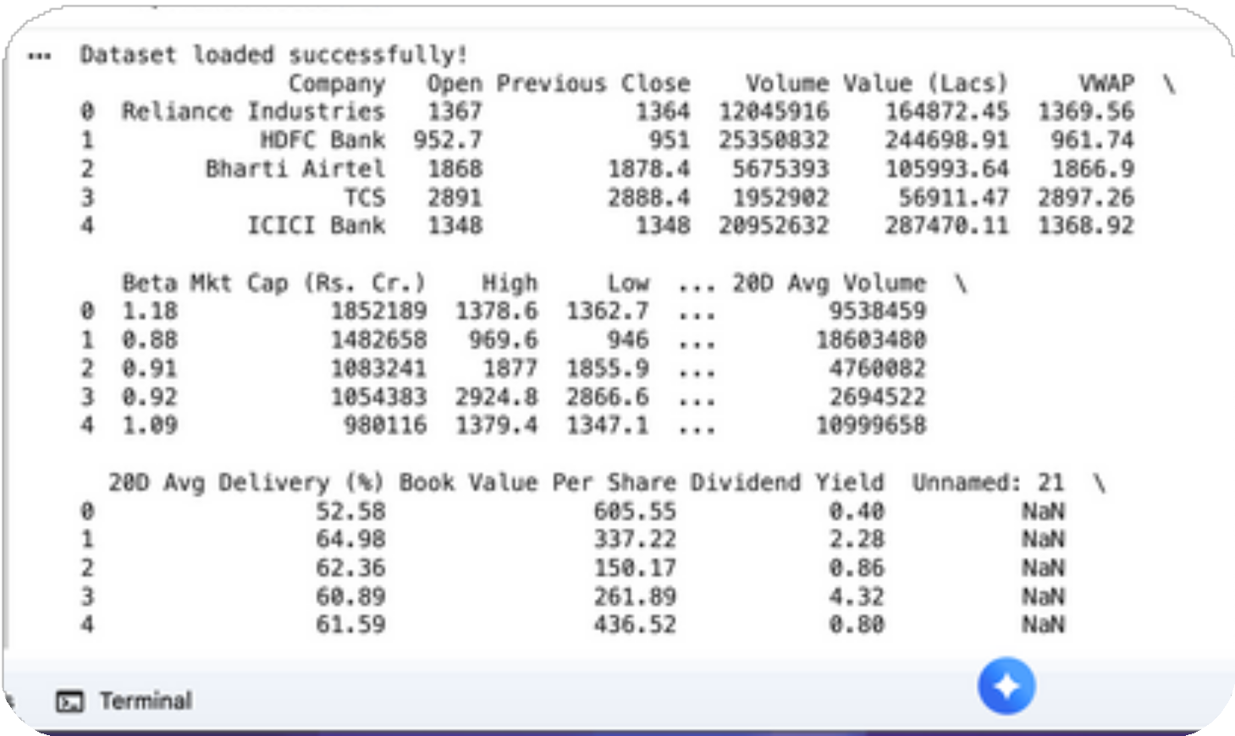
Data Overview
Dataset Details
Dataset: NIFTY 50 constituent stock data
Period Covered: Historical data of last 3–5 years (customizable) for some unlisted values
Data Sources:
Yahoo Finance API NSE India (Official API)
Manual entries for the Company’s Info

Slide 4



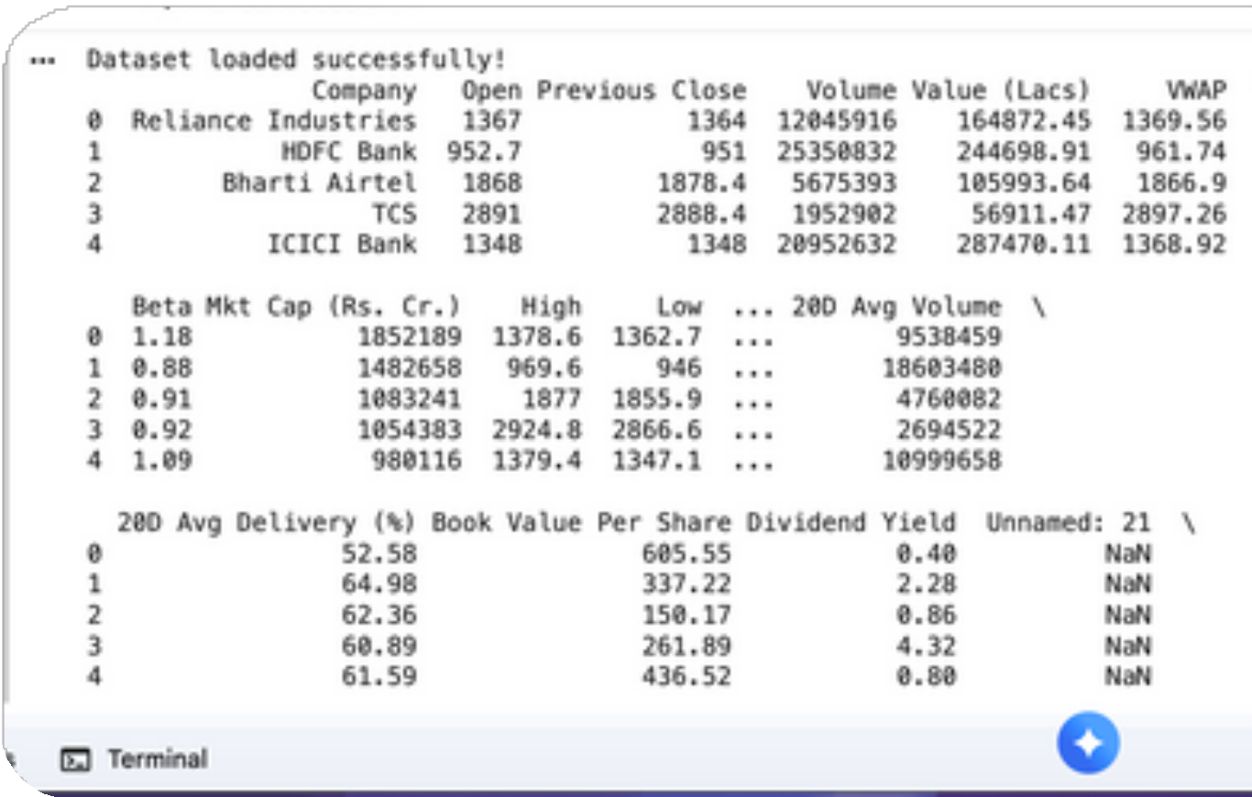
Data Overview
Features Considered
Market Variables:
Open, Close, Volume, Market Cap, PE Ratio
Risk Variables:
Beta, Volatility, Sharpe Ratio, VWAP
Derived Metrics:
Daily Returns, CAGR (Compounded Growth Rate), Standard Deviation
Annual
Target Variables
Risk Category → Classification Label (Low / Moderate / Aggressive / High)
Expected Return → Numerical Output for Regression Models

Slide 5








Methodology Overview
Risk Classification Phase (Supervised Classification)
Objective: Categorize each Nifty 50 stock into Low, Moderate, Aggressive, or High-Risk groups.
Criteria: Based on historical volatility, Beta values, and past return patterns.
Model Used: Random Forest Classifier (for accuracy and interpretability).
Outcome: Clear segmentation of stocks by risk profile.

Slide 6







Methodology Overview
Return Prediction Phase (Supervised Regression)
Objective: Predict expected future returns for each stock.
Inputs: Classified stock data + key financial indicators. Model Used: Linear Regression / Random Forest Regression. Outcome: Estimated returns for portfolio optimization.

Slide 7




Portfolio Construction
Methodology
Approach:
Stocks classified by predicted risk (Low, Moderate, High, Very High).
Diversified allocation using Dirichlet-distributed random weights.
Portfolios designed as:
Conservative: Low risk, steady returns Moderate: Balanced risk-reward Aggressive: High growth focus
High-Risk: Speculative, maximum volatility
Metrics Computed:
Expected Return: Weighted average returns
Portfolio Volatility: Overall risk measure
Sharpe Ratio: Risk-adjusted performance indicator

Slide 8
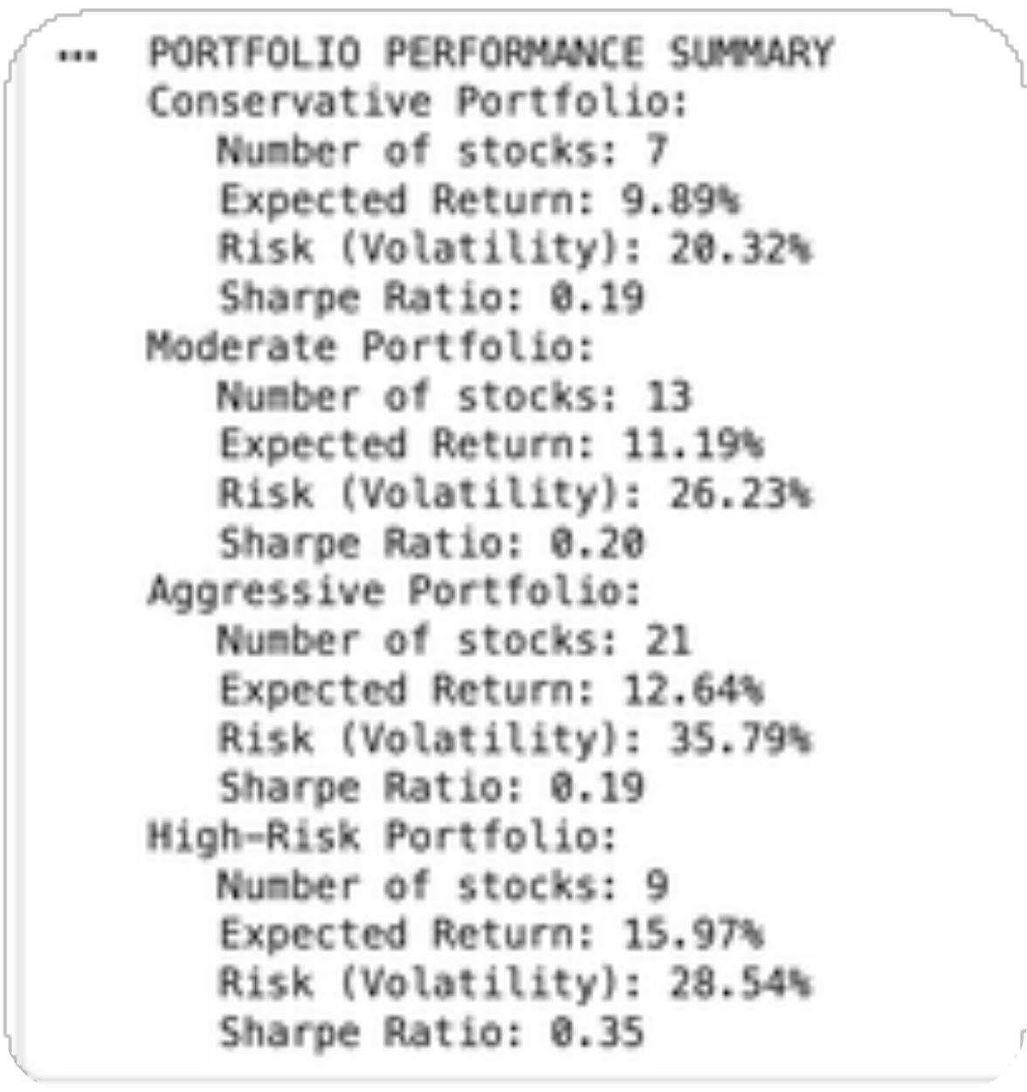


Key Insights
Higher risk = Higher return (risk-return tradeoff confirmed).
High-risk portfolios delivered top returns but also high volatility.
Conservative portfolio offers stability for risk-averse investors.
Perfo^{P}rºm^{rt}a^{f}nºc^{lio}e
Results

Slide 9




Model Evaluation
Summary
Classification Models:
Random Forest Classifier achieved 80% accuracy, effectively identifying stock risk categories by learning complex, non- linear relationships.
Logistic Regression reached 70% accuracy, serving as a strong baseline but limited by its linear decision boundaries.

Slide 10
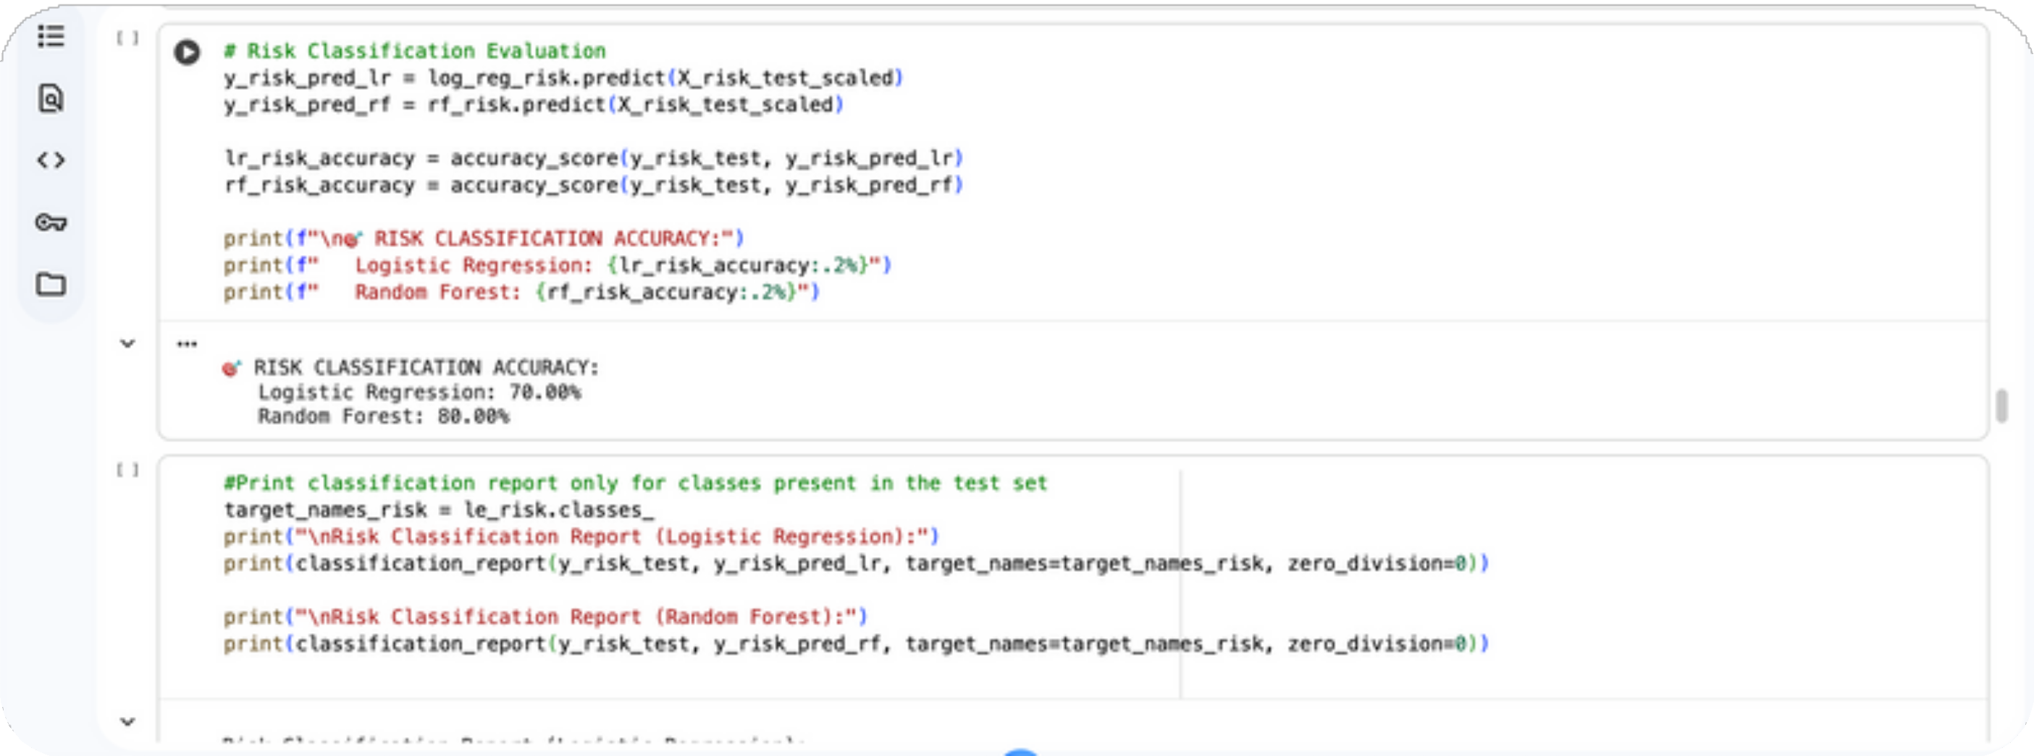

Slide 11




Model Evaluation
Summary
Regression Models:
Random Forest Regressor delivered an R² score of 0.87, showing high reliability in predicting expected stock returns.
Linear Regression achieved an R² score of 0.64, performing well but less capable of capturing multi-factor dependencies.

Slide 12
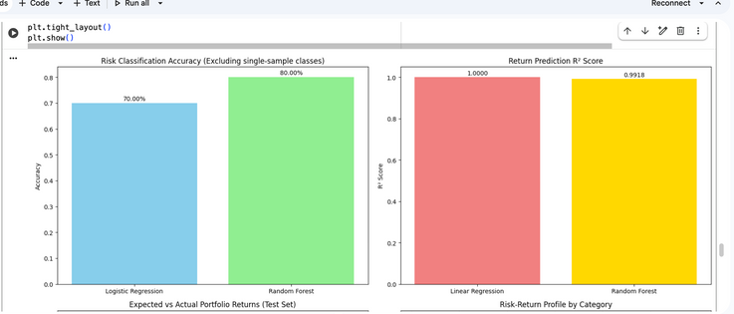
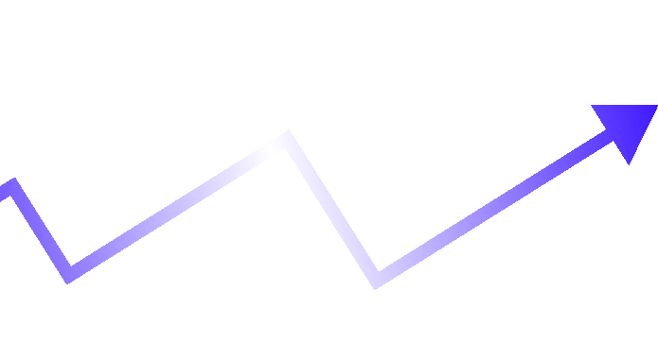

Slide 13



Portfolio Returns & Risk Analyser
(Streamlit App)
Key Features:
Accepts stock inputs such as Beta, PE Ratio, Volatility, and Market Cap. Predicts each stock’s risk category and expected return using trained ML models.
Automatically groups stocks into Conservative, Moderate, and Aggressive portfolios.
Displays portfolio-level metrics — Expected Return, Average Risk, and Sharpe Ratio.
Highlights top-performing stocks under each portfolio with their predicted returns.
Offers a clean, dark-themed dashboard with an intuitive sidebar and real- time updates.

Slide 14
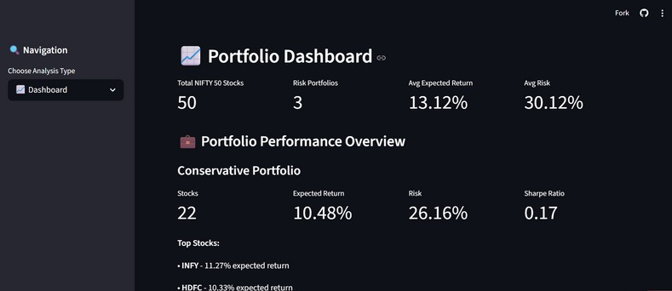
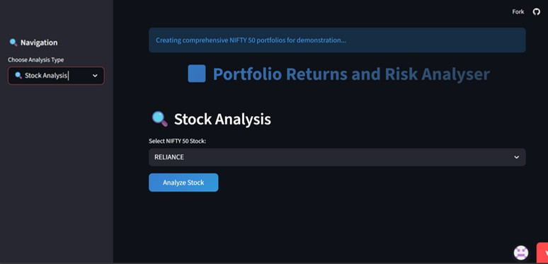
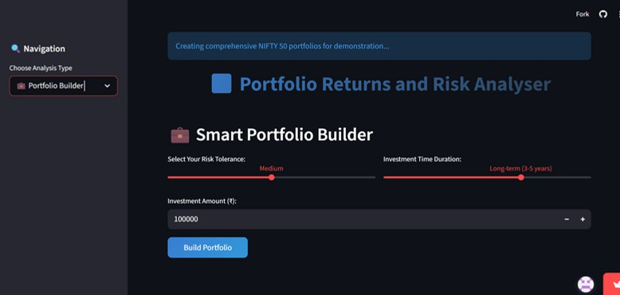
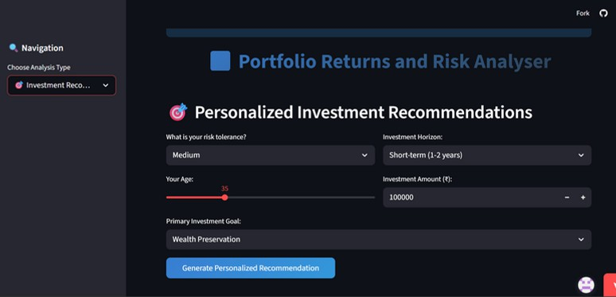


Slide 15



Key Learnings
Applied machine learning concepts to real-world NIFTY 50 financial data, bridging theory with practical market insights.
Strengthened understanding of risk–return optimization and how model selection impacts investment outcomes.
Developed and deployed an end- to-end ML dashboard using Streamlit, translating analysis into actionable predictions.

Slide 16
Conclusion
Future Scope:
ML effectively quantified risk levels and expected returns for NIFTY 50 stocks.
Integrate real-time market and sentiment data for dynamic insights. Use Reinforcement Learning for portfolio rebalancing.
Expand analysis to sectoral and global portfolios.
Portfolio results highlighted clear risk–return tradeoffs for different investor types.
Random Forest delivered the best performance in both classification and regression, proving reliable for financial prediction tasks.

Slide 17
Thank You

